Slide 1

FIRE EMERGENCY EXIT SYSTEM
Haard Patel – 15012101026
Khush Patel – 15012101031
Neel Patel – 15012101036
Reeya Patel - 15012101038
Guided by –
Prof. Nidhi Thacker
Prof. Hirav Shah

Slide 2
Project Definition
In this project ,we have used thingspeak to send data which is detected by the temperature sensor(AM2302)
In that it will store the data (temperature data) continuously on thing speak and it will also show in the form of graph
The stored data can be downloaded in the form of csv file.

Slide 3
Cont…
In this proposed project, the main objective is to detect the temperature inside the bus and if incase fire occurs then the emergency window in the bus will be pulled up through rotating motor, so it can work as exit window for the passengers.
It will also work during summer season if incase the temperature inside bus rises above the defined level, the window will be pulled up, resulting in circulation of air inside the bus and lowering the temperature.

Slide 4
LITERATURE REVIEW
Name | Bus Fire Safety.
Link | http://www.diva-portal.org/smash/get/diva2:962472/FULLTEXT01.pdf
Type | Report
Proposed | The roof hatches are very effective in ventilating fire smoke. Therefore automatic opening of roof hatches triggered by the driver would be useful.

Slide 5
LITERATURE REVIEW
Name | ‘emergency exit’ for buses
link | https://www.deccanchronicle.com/150725/nation-current-affairs/article/bengaluru-students-devise-automatic-%E2%80%98emergency-exit%E2%80%99-buses
Type | article
Proposed | Sensors would be placed across the bus. If the bus catches fire, the sensors detect and activate the linear actuator.
Name | ‘emergency exit’ for buses
link | https://www.deccanchronicle.com/150725/nation-current-affairs/article/bengaluru-students-devise-automatic-%E2%80%98emergency-exit%E2%80%99-buses
Type | article
Proposed | Sensors would be placed across the bus. If the bus catches fire, the sensors detect and activate the linear actuator.

Slide 6
Cloud Based Development Work:
ThingSpeak™ is a free web service that lets you collect and store sensor data in the cloud and develop Internet of Things applications.
The user can create his/her own channel on the website, where he/she can create private/public channel’s in his/her account, to use that channel to upload data from arduino device and export that same data into a csv file.

Slide 7
We have created a private channel on thingspeak.
The update_id of that channel is than inserted in the Arduino code, so the data obtained in output is uploaded on the channel.
Update_id use for communication of Arduino console with Thingspeak

Slide 8
AT Commands:
The AT command is used in GSM module, which will connect Arduino with ThingSpeak to create the communication channel.
AT command is used in obtaining Local IP Address of the GSM Module.
Than it will start the connection to connect Arduino with ThingSpeak.
After the connection is successful, the data of Arduino will be uploaded on ThingSpeak.

Slide 9
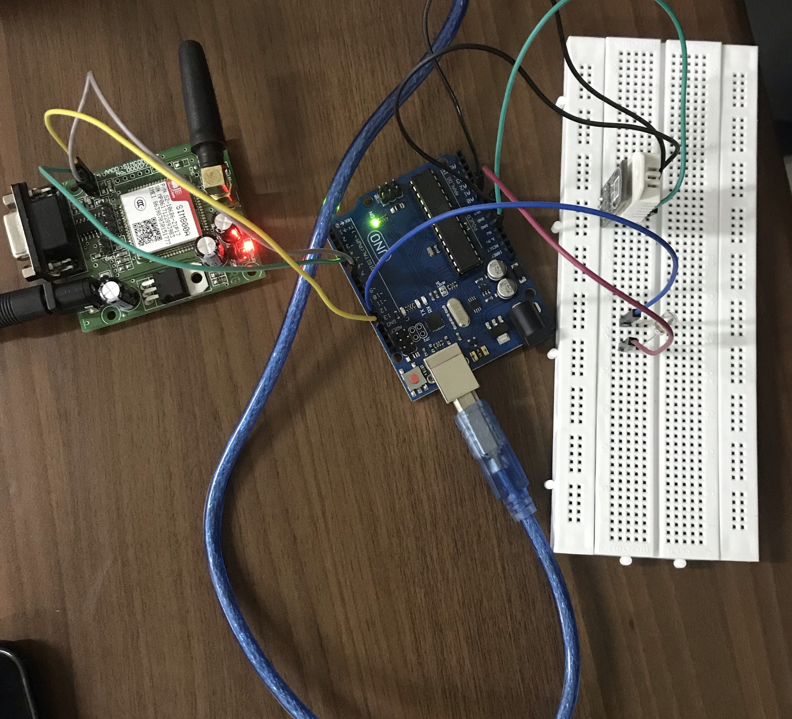
Implementation Work

Slide 10
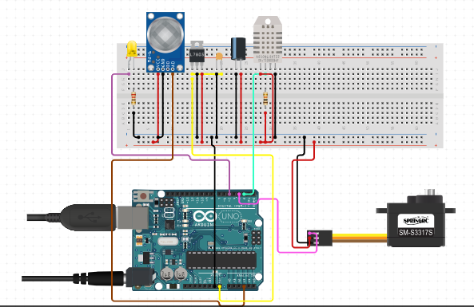
Circuit Diagram:

Slide 11
Future Scope:
We would like to extend this project into real life implementation bus system implementations.
Apart from this also system that can predict the accidents and other problems in bus.
Hydraulic and fully automated window system can also be implemented in near by future.

Slide 12
CONCLUSION
We learnt many new concepts like
MQ2 sensor and its real life implementations.
Cloud data System and Graph based APIs.
Different AT Command
GSM Module and Its versions
Integrations in Big Projects

Slide 13
Q & A

Slide 14
Thank You

